Slide 1
Welcome to My Engineering Exploration
Hello everyone, I'm Wudase Mehari,and I'm excited to share my journey exploring various engineering fields.
This presentation summarizes my key learnings, insights, and future aspirations in these fields.

Slide 2
Diving into Software Engineering
Learning outcomes:
The importance of clean, maintainable code
Data structures and algorithms
Software development lifecycle
Developing web applications and mobile apps

Slide 3
Understanding Civil Engineering
Learning outcomes:
The importance of structural integrity and safety
The impact of infrastructure on society
The role of mathematics in civil engineering
Application :
In construction of Bridges, buildings,and infrastructure

Slide 4

Aeronautical Engineering
Key concepts:
Aerodynamics and fluid mechanics
Aircraft propulsion systems
Aircraft structures and materials
Flight control systems

Slide 5
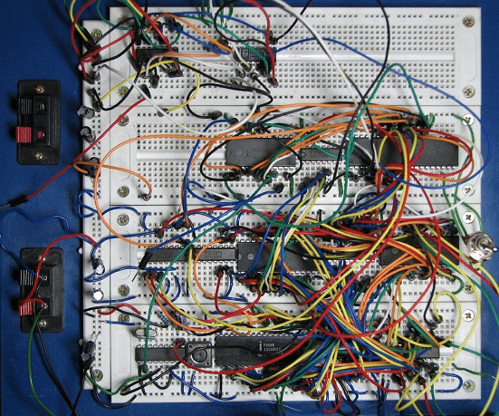
Electrical Engineering
Important Topics:
Circuit analysis and design
Digital logic and microcontrollers
Signal processing and communication
systems
Power systems and renewable energy

Slide 6
Challenges and Overcoming Them

Slide 7
Navigating Challenges
Throughout my exploration, I encountered challenges such as:
Understanding complex algorithms
Grasping advanced engineering concepts
Time management (since I am full time student )
I overcame these challenges by:
Seeking help from online resources and mentors( Khan academy ai tool )
Breaking down complex problems into smaller, manageable parts
Puting deadline for task's

Slide 8
General Experience
Through out this pre engineering course I have gained a valuable insight on basic engineering concepts and motivate me to deepen my knowledge on civil engineering.
Through out the journey

Slide 9
Conclusion
My key takeaways from this exploration include:
The power of software in solving real-world problems
The importance of sustainable engineering practices
The potential of engineering to shape the future
In the future, I aspire to:
Pursue a career in architectural engineering

Slide 10
Thank you
Name- Wudase Mehari
Email address - wudasemehari4@gmail.com
Jan 5,2025

